Slide 1

REDUCING CLAUSES TO PHRASES WITH “ING”

Slide 2
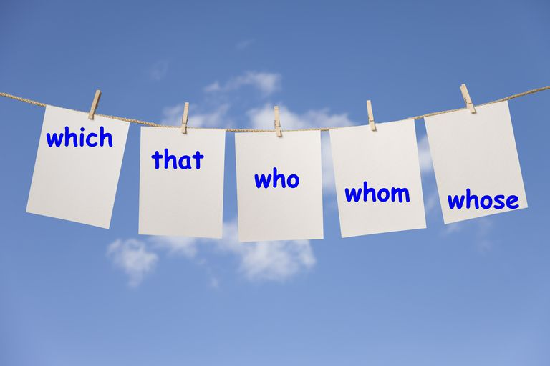


Relative Pronouns

Slide 3
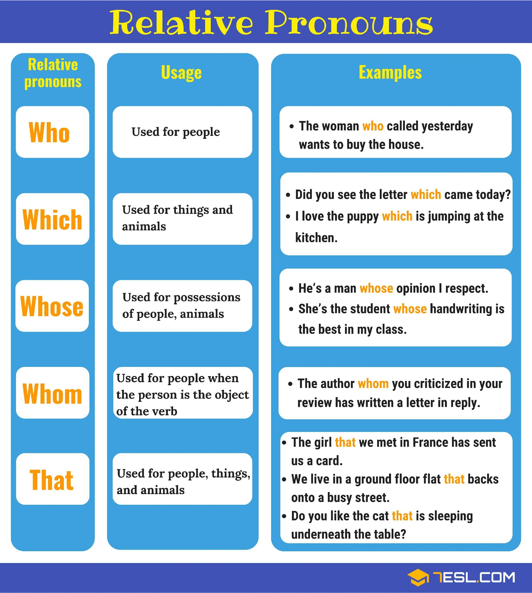
We use relative pronouns to introduce relative clauses, which tell us more about people and things.

Slide 4
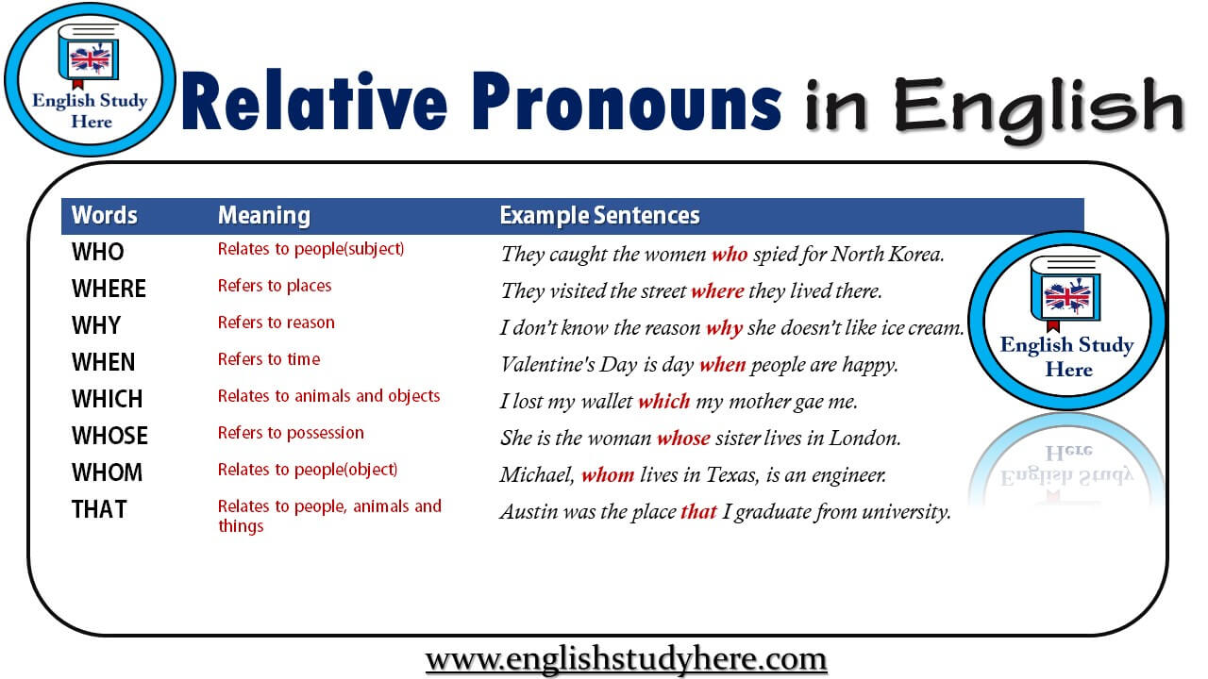

Slide 5
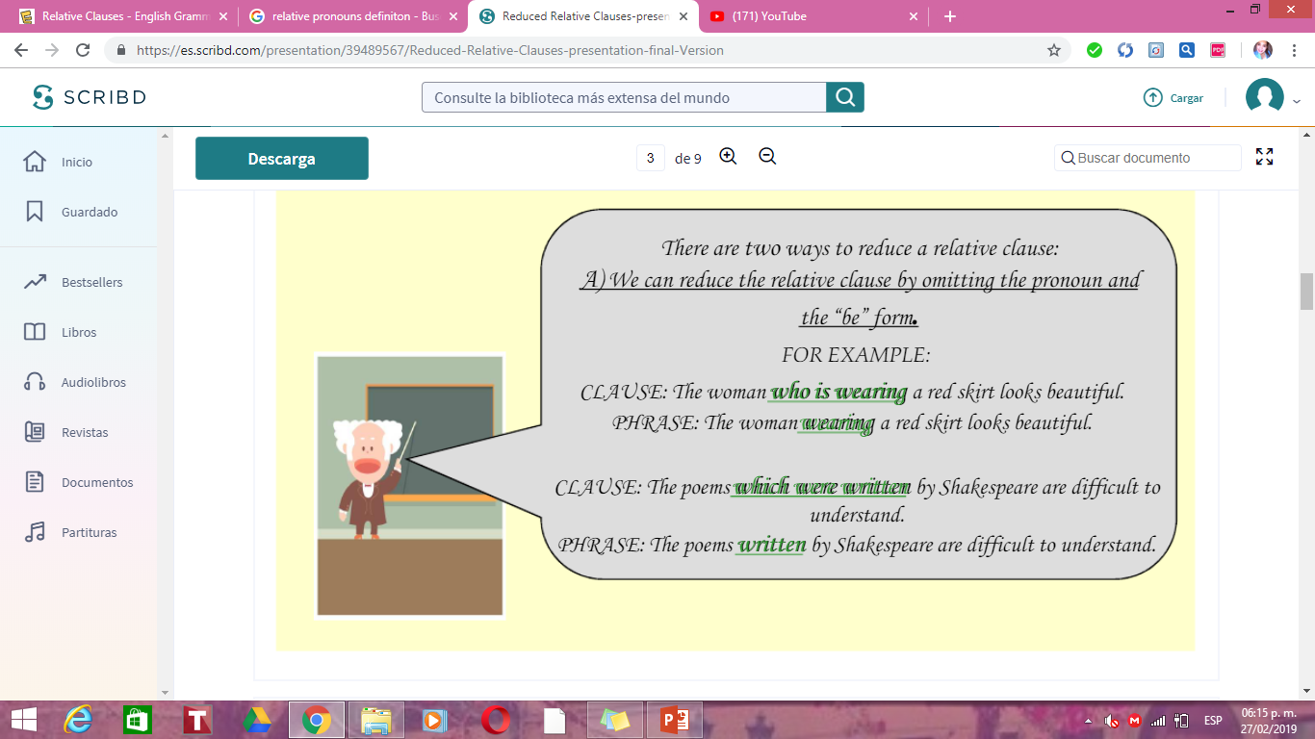

Slide 6
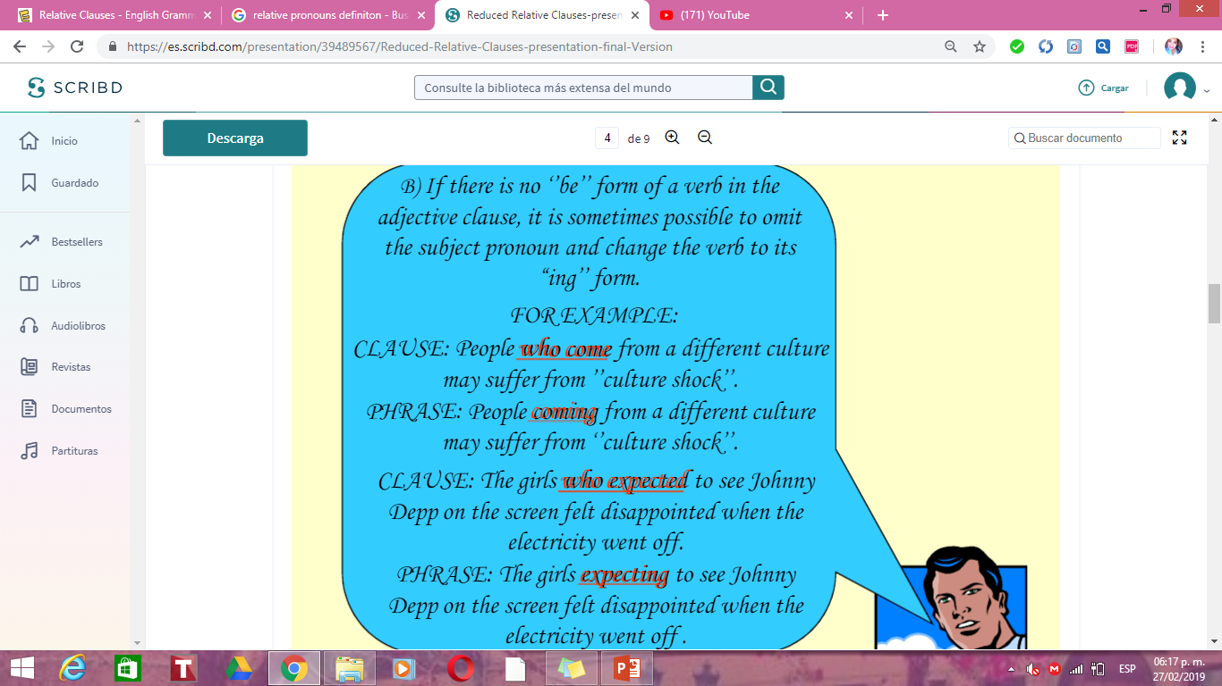

Slide 7
RELATIVE PRONOUN
VERB BE
Verb + “ing”
Julia is on the train that is arriving at platform 3
Julia is on the train arriving at platform 3

Slide 8
RELATIVE PRONOUN
VERB
Verb + “ing”
The students that pay on time will have a 20% discount
The students paying on time will have a 20% discount.

Slide 9

The girl who sits next to Peter is my neighbor’s daughter.
Who sits
The girl sitting next to Peter is my neighbor’s daughter.
The girl who works at a pub has won a lottery.
Who works
A girl working at a pub has won a lottery.

Slide 10
The lady who lives next door throws many parties.
Who lives
The lady living next door throws many parties.
Anyone who enters the garden without permission will be punished.
Who enters
Anyone entering the garden without permission will be punished.

Slide 11
The feature that makes the biggest difference to customers is cost.
that makes
The feature making the biggest difference to customers is cost.
The money which is being collected will go to help a new orphanage
Which is being
The money being collected will go to help a new orphanage.

Slide 12
CHOOSE THE CORRECT ANSWER:
1. The men that are working on the project come from India.
a) The men working on the project come from India.
b)The working men on the project come from India.
c) The working on the project men come from India.
2. The students who study at our school come from all over the world.
a) The studying students at our school from all over the world.
b) The students studying at our school come from all over the world.
c) The studying at our school students come from all over the world.

Slide 13
MAKE A REDUCED RELATIVE CLAUSE IN THE FOLLOWING SENTENCES
My Friends who were living in dorms had a very hard time
People who litter will have to pay a fine
The man who is buliding the new school is my dad
Any student who wishes to join the competition should consult with their tutor first
The girl who is wearing a red dress is my cousin.
Dont wake the baby that is sleeping in the next room.
Those plants that are growing so beautifully are my grandma’s favorite.
We broke the computer that belongs to my father.
Who is that boy that is walking in the woods.
Citizens that break the laws will be sanctioned.

Slide 14


Slide 15
https://es.slideshare.net/fhertown/sentences-with-reduced-clauses
https://www.youtube.com/watch?v=_rpALfwqUeU
https://es.scribd.com/presentation/39489567/Reduced-Relative-Clauses-presentation-final-Version

